Slide 2
GOVT. DIGVIJAY. AUTONOMOUS. P.G.COLLEGE. RAJNADGAON (C.G)
PRESENTATION TOPIC
ON
DISEASE DUE TO VIRUSES
MOSAIC OF TOBACCO,LEAF CURL OF TOMATO,YELLOW VEIN MOSAIC OF BHINDI,BUNCHY TOP OF BANANA
GUIDED BY PRESENTED BY DR.KIRAN JAIN MAM KOMAL KUMAR YADU
DEPARTMENT OF BOTANY M.Sc. FOURTH SEMESTER

Slide 3
SYNOPSIS :-
INTRODUCTION
FEATURE
HISTORY
VIROIDS
CHEMICAL COMPOSITION
PROTEIN
NUCLEIC ACID
DISEASE DUE TO VIROSES
1.Mosaic of tabacco
2.leaf curl of tamato
3.yellow vein mosaic of bhindi
Management
Conclusion
REFERENCE

Slide 4
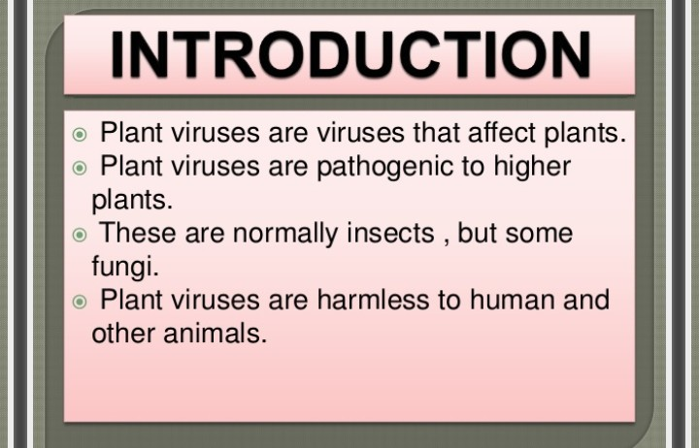

Slide 5
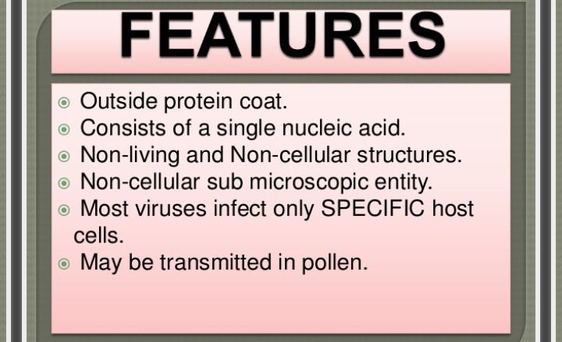

Slide 6
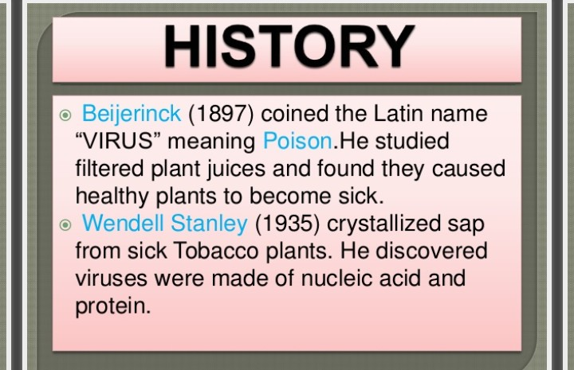

Slide 7
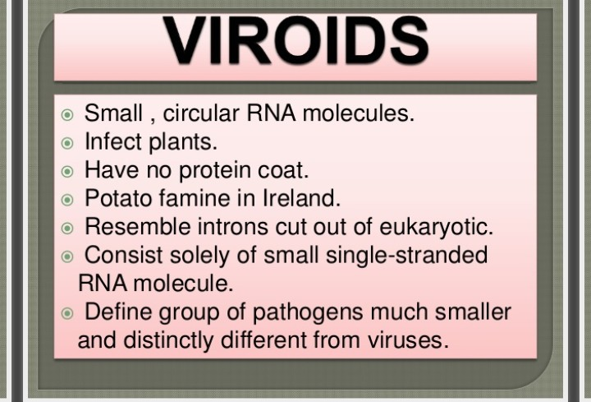

Slide 8
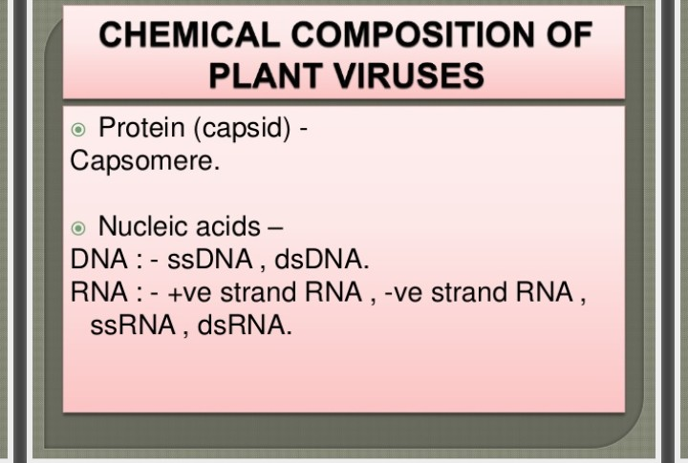

Slide 9
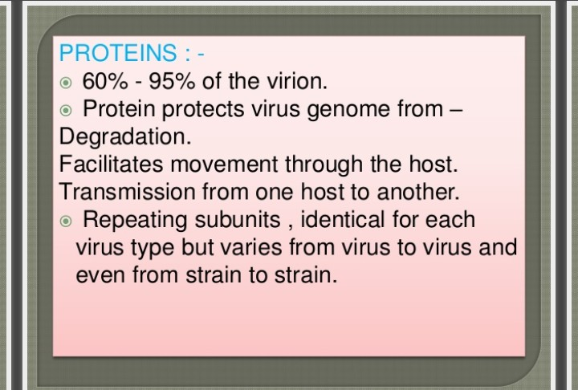

Slide 10
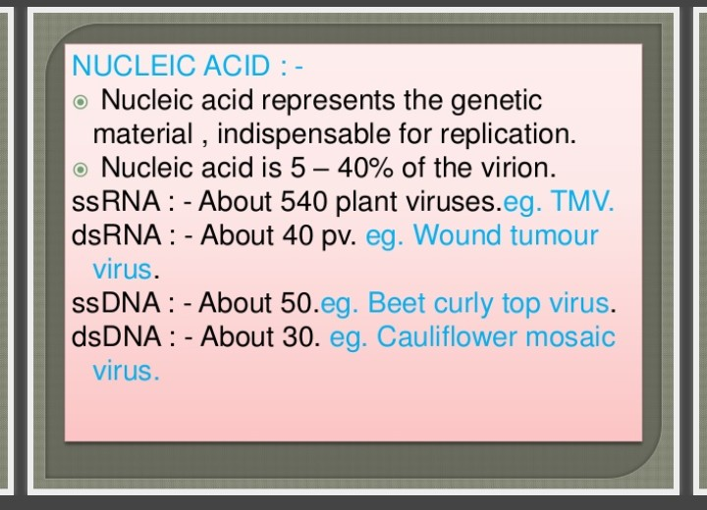

Slide 11
MOSAIC OF TOBACCO
INTROFUCTION
SYMPTOMS
TRANSMISSION
CONTROL OF TMV

Slide 12
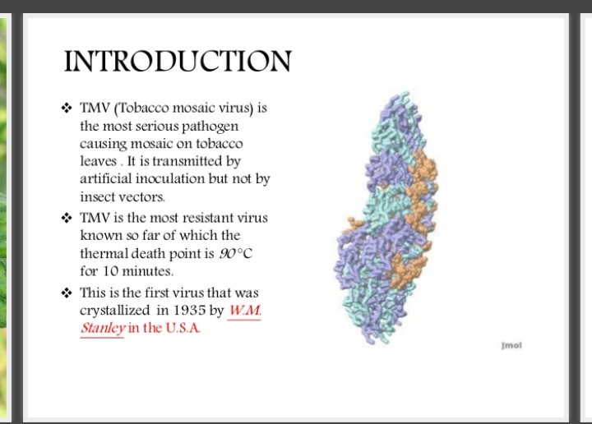

Slide 13
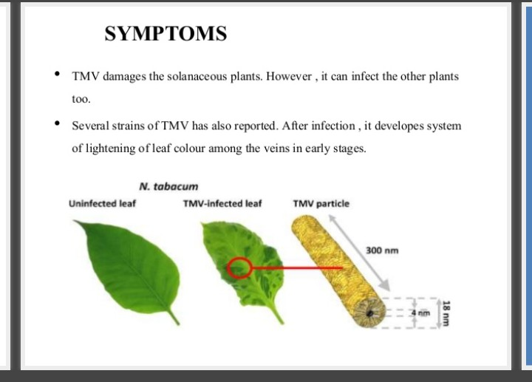

Slide 14
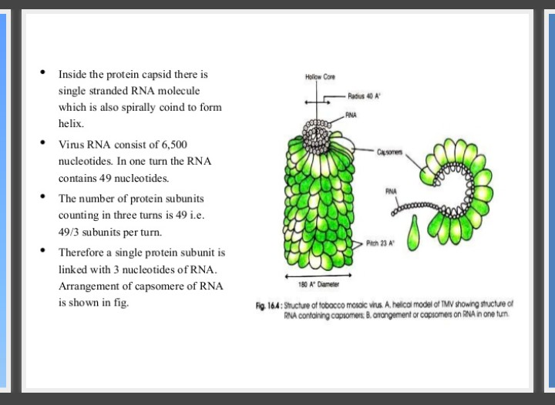
FIG- STRUCTURE OF TABCCO MOSOIC VIRUS : A. Helical model of TMV showing structure of RNA containing coposment B. Arrangement of copsoment on RNA in one turn .

Slide 15
TRANSMISSION:-
TMV is transmitted through the cell sap of host and enters a new host through wound incision . Wound is caused in plant due to various cultural operations such as clipping or topping the shoot .
It is seed transmitted but act as seed contaminant . It is also transmitted by wind and water . Various control methods of the disease are regular roguing disease plants and weeds , sanitation and use of resistant varieties.

Slide 16
CONTROL OF TMV
TMV occurs in tobacco – growing areas , and is considered to be one of the moist important tobacco viruses economically .
Insects are not important in its spread . Control is by crop rotation , effective sanitation and use of resistant cultivars of tobacco .
For the first , TMV has used to demonstrate for development of coat protein – mediated , replicas – mediated resistance ,replicas ,and movement protein – mediated resistance.

Slide 17
LEAF CURL OF TOMATO:-
Tomato Yellow Leaf Curl Virus is transmitted exclusively by the whitefly Bemisia tabaci.
Leaflet are quite abnormal in shape with small size and low developments.
Recent leaves are shrinked , old leave are abnormal in shape .

Slide 18
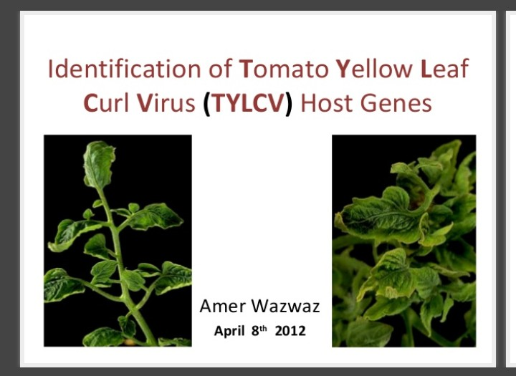

Slide 19
SYMPTOMS OF DISEASE :-
Leave give leathery texture and look thick .
Infected plant give bushy appearance .
Young leave become yellowish.
Leave may look wilted.
Margins of leave inward and outward .

Slide 20
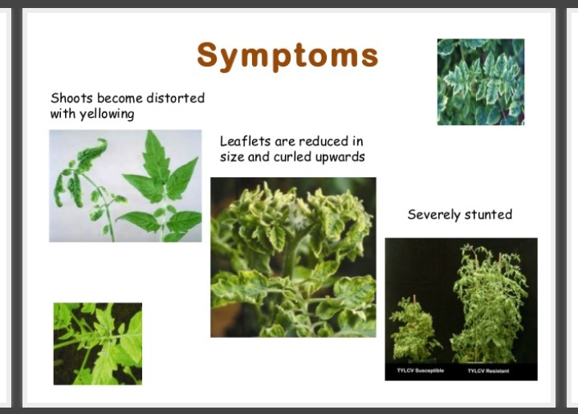

Slide 21
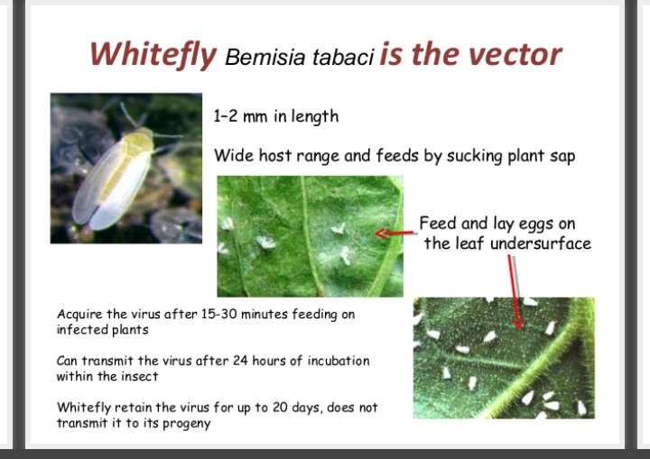

Slide 22
TRANSMISSION:-
It is seed borne , but the seeds of freshly infected fruits may nr contaminated.
The principal is Besisia tabaci.

Slide 23
DISEASE MANAGEMENT :-
There is no definite measure . Lycopersicon peruvianum shows a high degree of resistance .
Spraying with Ekatox 0.20% and Rogor 0,05% at intervalts of ten days helps toreduce incidence of the disease.
There are indications that growth regulators like Gibberelic acid and 2,4 – D reduce disease incidence and increase the yield of fruits.

Slide 24
YELLOW VEIN MOSAIC OF BHINDI :-
INTRODUCTION
SYMPTOMS
CAUSAL VIRUS
TRANSMISSION
DISEASE MANAGEMENT

Slide 25
INTRODUCTION :-
Yellow vein mosaic disease of bhindi is a serious problem wherever this crop is grown in India .
When the infection is early , the entire crop is deatroyed .

Slide 26
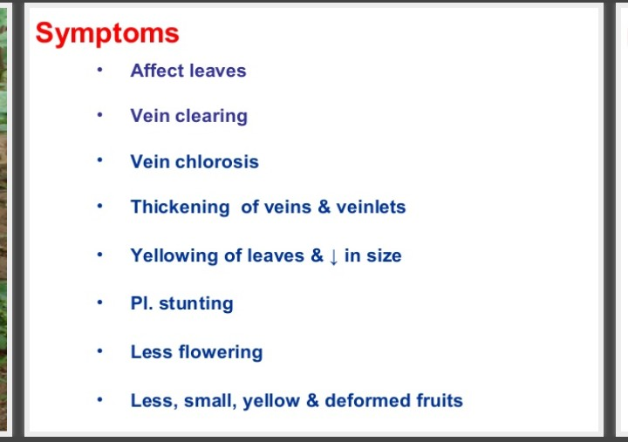

Slide 27
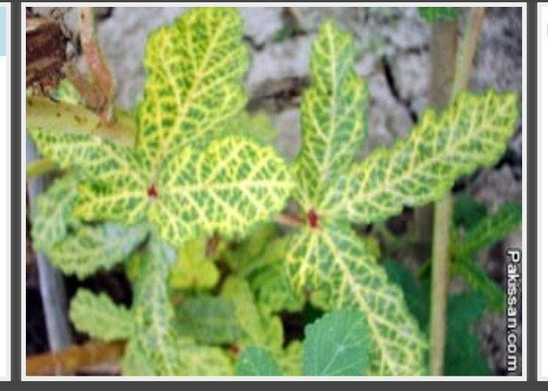
FIG- YELLOW VEIN MOSAIC OF BHINDI SYMPTOMS

Slide 28
CAUSAL VIRUS:-
The virus responsible for the disease is Hibiscus virus 1 or yellow mosaic virus .
Not much is known of the nature and properties of this virus.

Slide 29
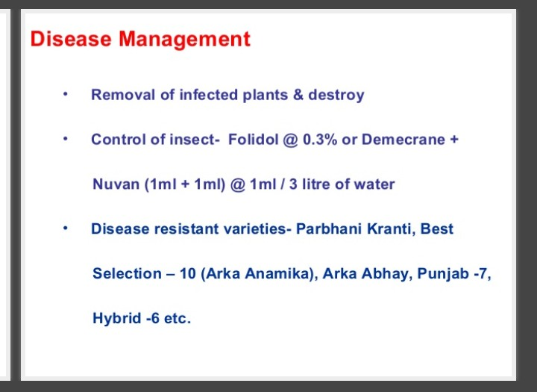

Slide 30
BUNCHY DISEASE OF BANANA:-
INTRODUCTION
OCCURRENCE
SYMPTOMS
TRANSMISSION OF BBTV
DISEASE CYCLE
MANAGEMENT

Slide 31
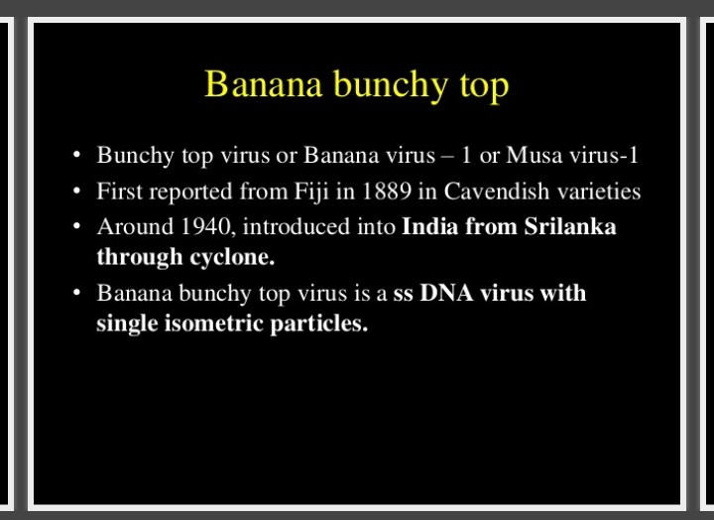

Slide 32
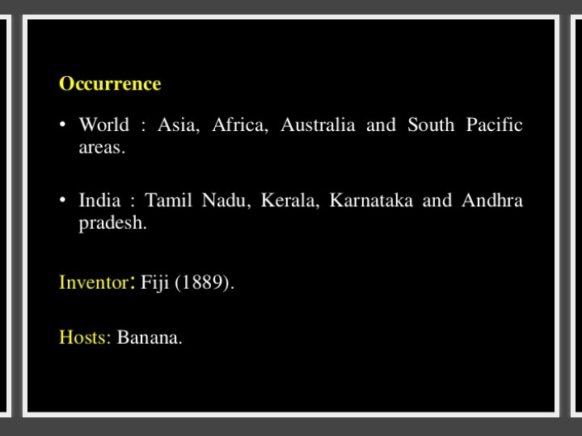

Slide 33
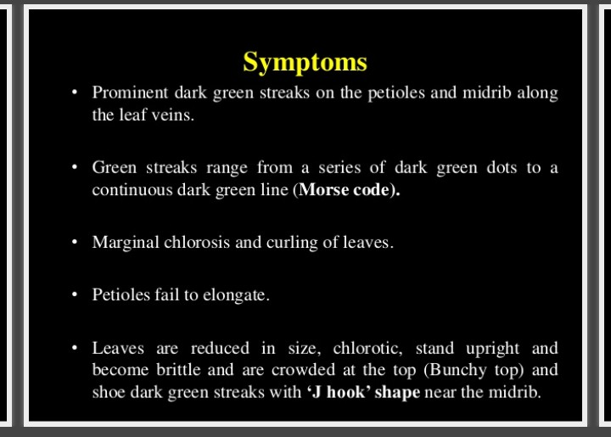

Slide 34
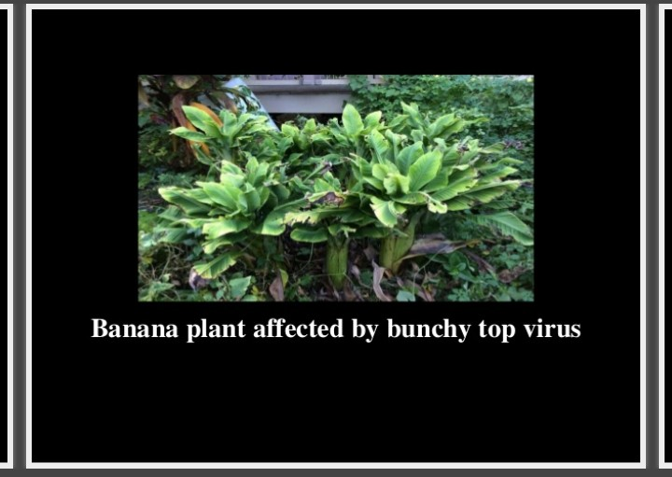

Slide 35
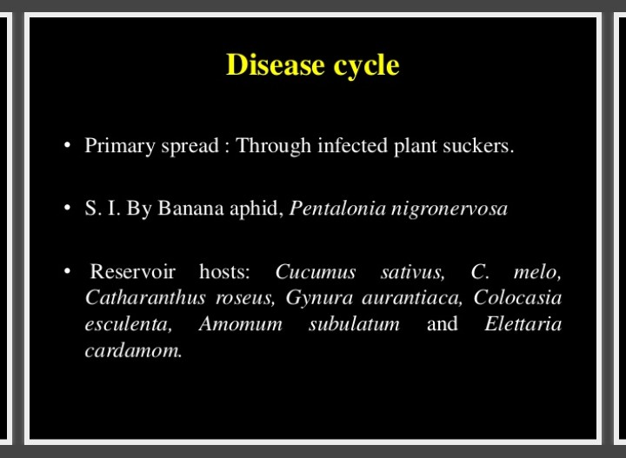

Slide 36
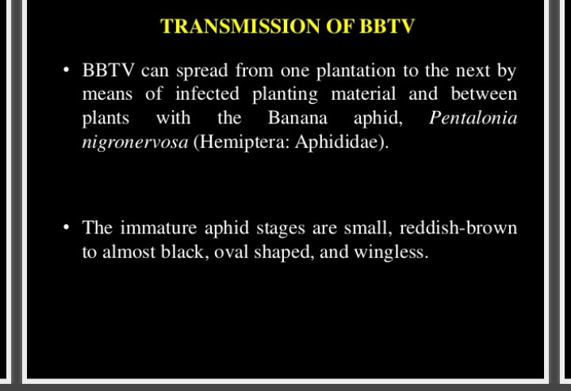

Slide 37
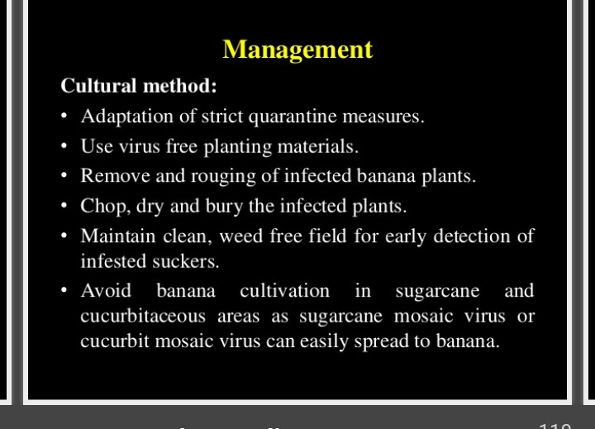

Slide 38
REFERENCE :-
R.S. MEHROTRA AND ASHOK AGARWAL – PLANT PATHOLOGY ,TATA McGraw HILL EDUCATION PRIVATE LIMITED, SECOND EDITION.
B.P. SINGH – PLANT PATHOLOGY ,AMAN PUBLISHING HOUSE LIMITED, 2004

Slide 39


